Slide 1
CSML1010 – Project Proposal
Group 11 – Alex Fung and Patrick Osborne
Instructor – Dr. En-Shiun Annie Lee

Slide 2

Twitter US Airline – Sentiment Analysis
Dataset from Twitter
14,640 thousand tweets
15 Features
6 US Airlines
Positive | Neutral | Negative
Aligns with a business problem
How to stop negative tweet trends before they go out of control?
Identify the early tweets accurately -> Sentiment Analysis!
Presents an interesting ML/Data challenge
Data is messy (Twitter character limit, slang, emojis, @ and #)

Slide 3
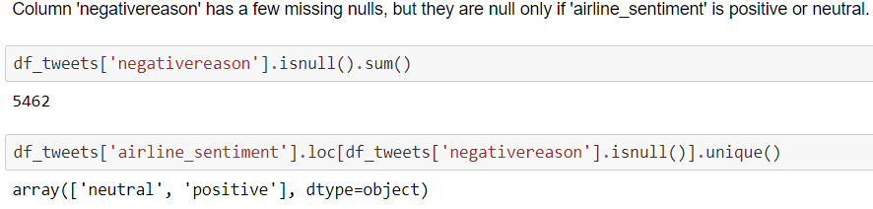
Loading Data
Loading Data
Available as CSV and SQL
UTF-8 encoding to preserve emojis 👍
Check for NULL Values

Slide 4


Cleaning Data
Twitter data notoriously unclean
Character limit forces non-standard English
Remove noise for sentiment analysis
@ Mentions, RT re-tweets
Retain value-adds
Emojis 💻, hashtags #
Add important context and content
Clean text itself
Remove HTML, translate slang, remove STOP words and grammar, lemmatize

Slide 5
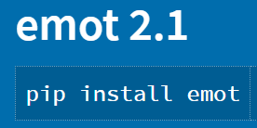
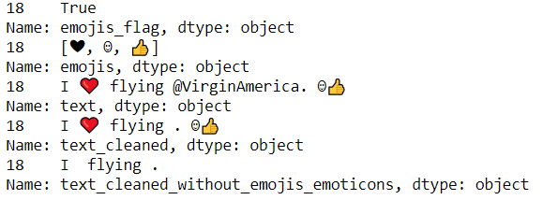
Data Cleaning Challenges
How to extract emojis?

Slide 6
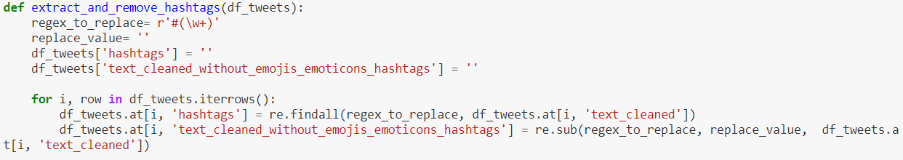
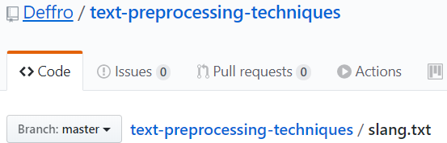
Data Cleaning Challenges
Extract Hashtags?
Text to lowercase
Convert Slang
Find and replace based on an existing dictionary

Slide 7

Text Cleaning
Remove stop words
“The”, “and”, “You”, etc. -> noise
Remove punctuation & numbers
Lemmatize
Tokenize

Slide 8
Data Exploration
15 columns
6 main features that interest us
airline_sentiment
airline_sentiment confidence
negativereason
negativereason_confidence
airline
text
Engineered Features
emojis
emoticons
cleaned text (lemmas)

Slide 9
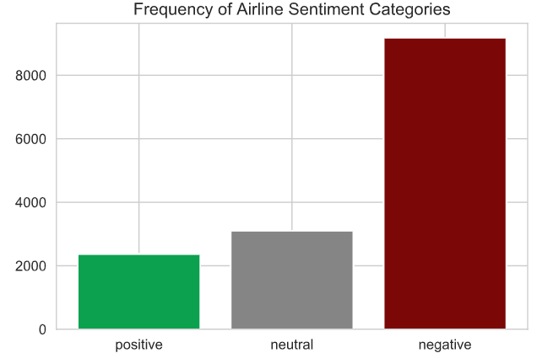
Data Exploration

Slide 10
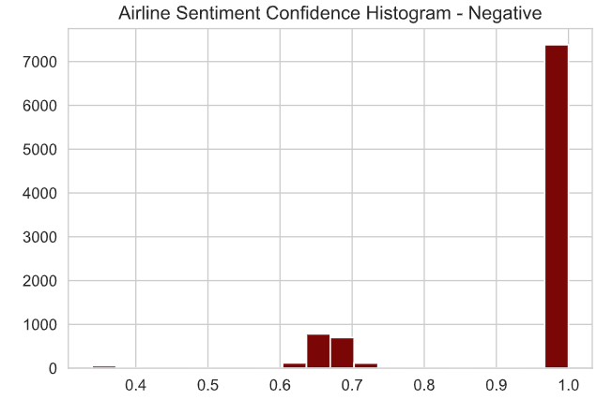
Data Exploration

Slide 11
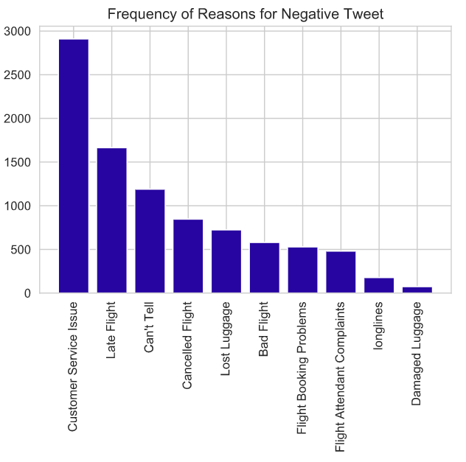
Data Exploration

Slide 12
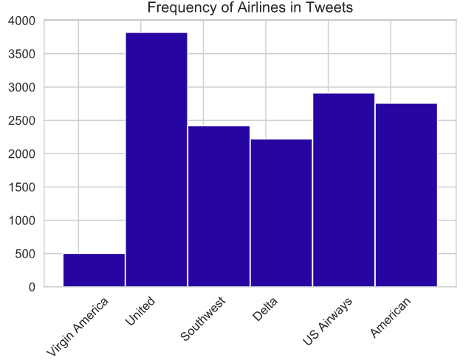
Data Exploration

Slide 13
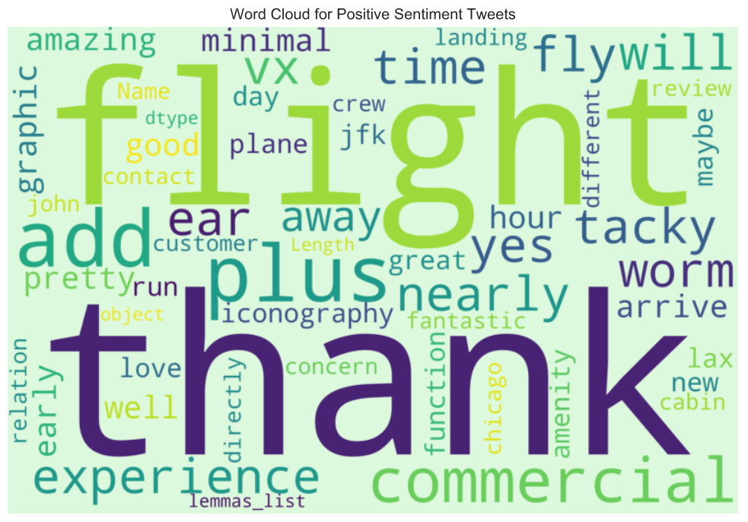
Data Exploration

Slide 14
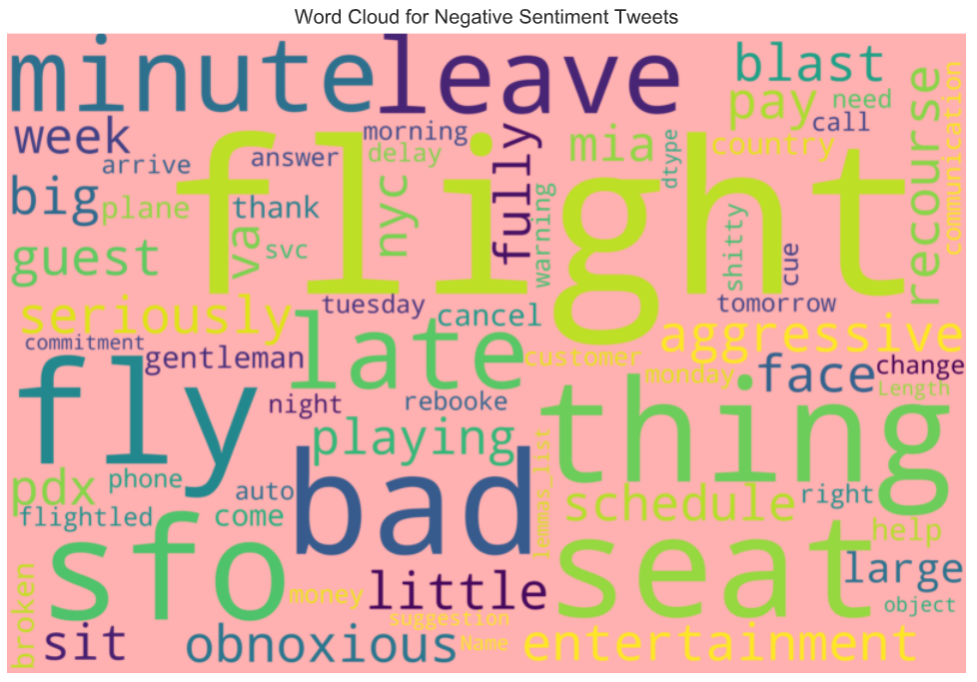
Data Exploration

Slide 15
Data Exploration – Emojis & Hashtags
Is there value in the extracted emojis and hashtags?
Method:
Plot frequency by sentiment class (positive, neutral, negative)
If there is a clear difference – emojis & hashtags are differentiators -> add context

Slide 16
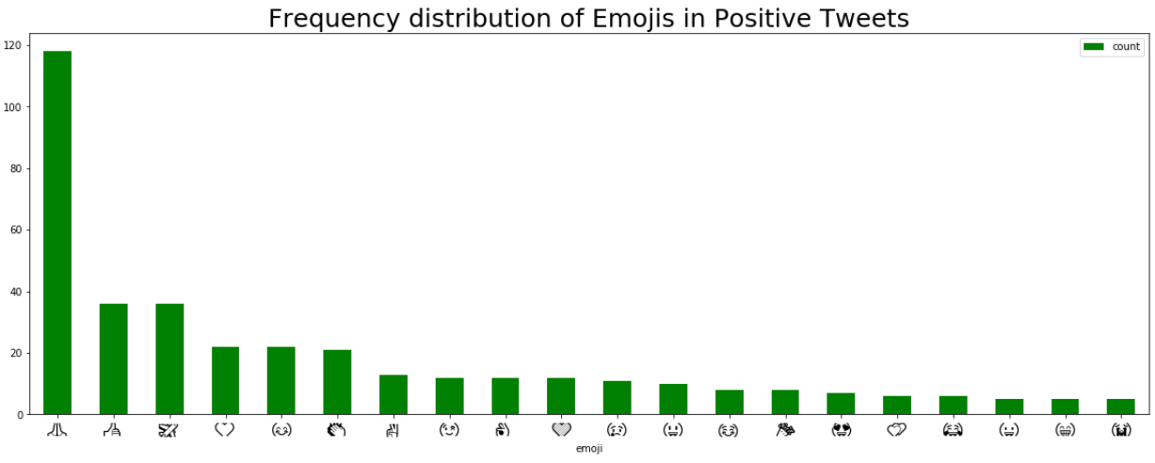
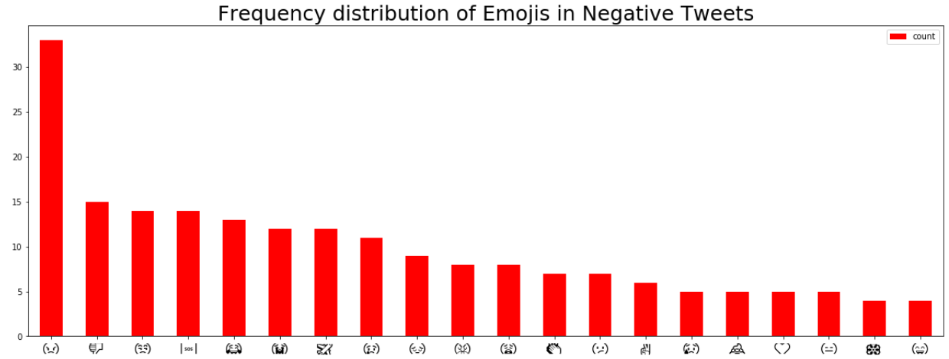

Slide 17
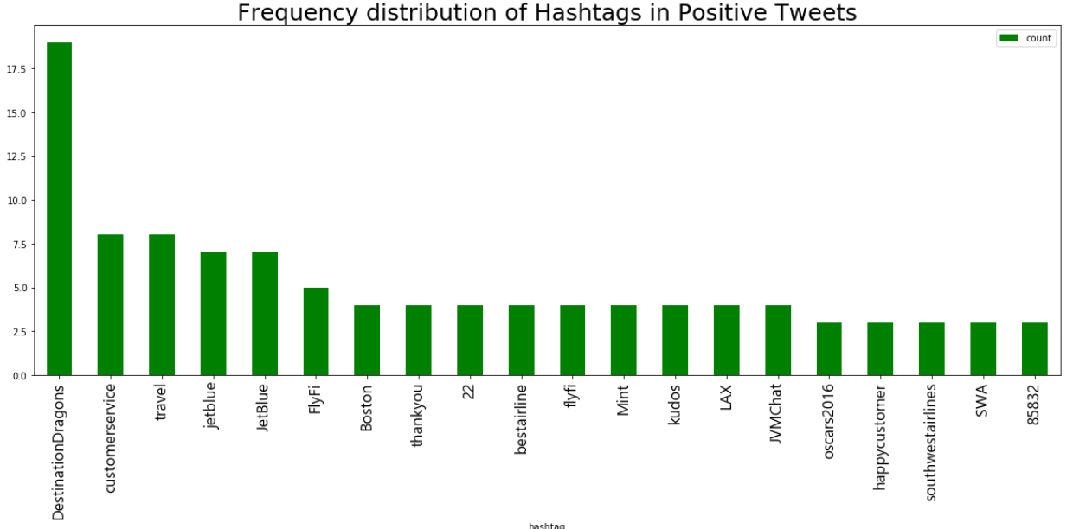
Data Exploration – Emojis & Hashtags

Slide 18
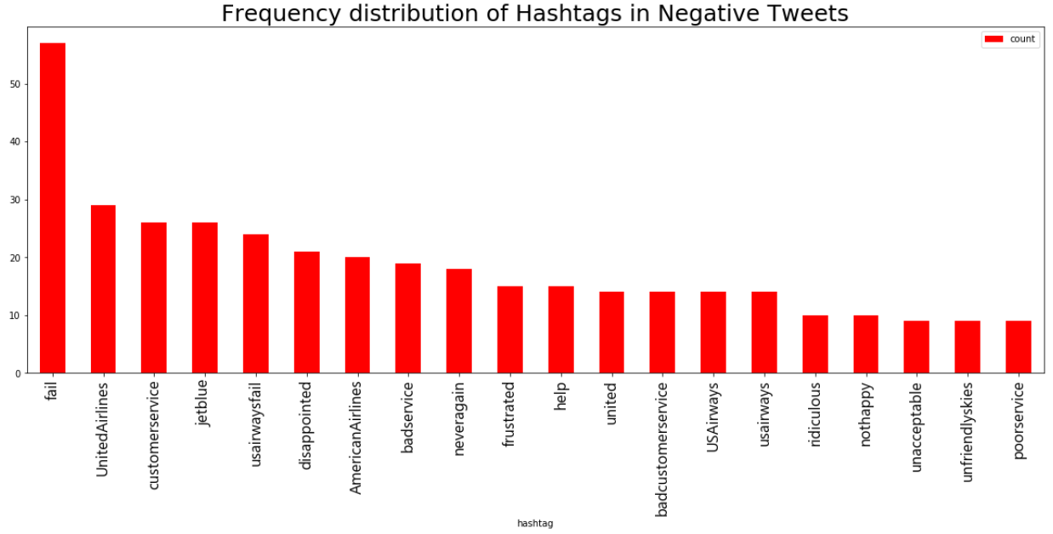
Data Exploration – Emojis & Hashtags

Slide 19
Data Exploration – Emojis & Hashtags
Issues with our emoji, emoticon and hashtag extraction
Extraction process confuses non-emoticon string of characters for an emoticon
E.g. time of day, airport codes
Hashtags could be cleaned further
Reduce to lowercase, remove stop words, lemmatize
Challenging as hashtags are not pure English

Slide 20
Thank You!

